Slide 1


Project Proposal Defense
Presentation
On
Prediction of alternative energy production using Linear regression
Presented By
Bilish Kharbuja(23869/076)
Binaya Limbu(23870/76)
Prayag Dhakal(23880/76)
Supervised By
Er. Dhiraj Kumar Jha

Slide 2
Presentation Outline
Introduction
Algorithm Details
Data Processing ( Input , Processing and Output)
Testing Methodology

Slide 3
Introduction
The potential to shape the future of energy production and sustainability using linear regression
Linear regression, a well-established statistical method, allows us to analyze historical data and uncover patterns, relationships, and trends.
Forecast alternative energy production.

Slide 4
Algorithm Details
In this project mainly linear regression algorithm is used.
Linear Regression is a supervised machine learning algorithm. It is used for predicting a continuous outcome variable based on one or more predictor variables.
The Linear Regression Equation: (Formula) Y = β0 + β1X1 + β2X2 + ... + ε
Y: Dependent variable (Energy Production)
Independent variable: X1, X2, ...:
Unknown parameters (Predictors) β0, β1, β2, ...:
ε: Error term

Slide 5
Flow of our project
Step 1: Import Libraries (pandas, numpy)
Step 2: Load data
Step 3: Create method for linear regression, MSE, MAE
Step 4: Build the model and fit the values on created method
Step 5: Make predictions
Step 6: Evaluate performance by passing predicted values to MSE and MAE methods

Slide 6
Linear Regression Formula
Y = β0 + β1X1 + β2X2 + ... + ε
Where,
Y: Dependent Variable
Independent Variables (Energy Production): X1, X2, …
Unknown Parameters (Predictors) β0, β1, β2,…
ε: Error term

Slide 7
Linear Regression Method
import numpy as np
def estimate_coef(x, y):
# number of observations/points
n = np.size(x)
# mean of x and y vector
m_x = np.mean(x)
m_y = np.mean(y)
# calculating cross-deviation and deviation about x
SS_xy = np.sum(y*x) - n*m_y*m_x
SS_xx = np.sum(x*x) - n*m_x*m_x
# calculating regression coefficients
b_1 = SS_xy / SS_xx
b_0 = m_y - b_1*m_x
return (b_0, b_1)

Slide 8
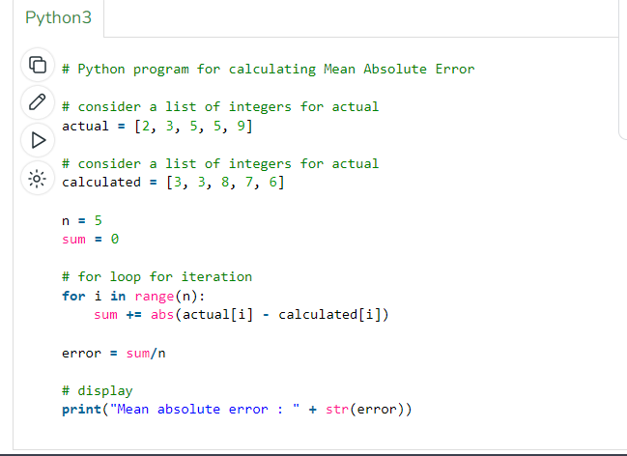
Formula for MAE
MAE = (1 / n) * Σ|yᵢ - ŷᵢ|
Where:
n is the number of data points.
yᵢ is the actual value for the i-th data point.
ŷᵢ is the predicted value for the i-th data point.
Σ represents the summation over all data points.

Slide 9
Formula for MSE
MSE = (1 / n) * Σ(yᵢ - ŷᵢ)²
Where:
n is the number of data points.
yᵢ is the actual value for the i-th data point.
ŷᵢ is the predicted value for the i-th data point.
Σ represents the summation over all data points

Slide 10
Data Processing ( Input-Processing-Output)
Data Collection: Gather historical data related to sustainable energy production. This data may include energy production records and relevant predictor variables such as weather data (e.g., temperature, sunlight, wind speed), time of day, equipment status, and any other factors that can influence energy production.
Data Cleaning: Perform data cleaning to address issues such as missing values, outliers, and inconsistencies in the data. Missing data can be filled in using imputation techniques, and outliers can be handled by removing or transforming them as needed.

Slide 11
Testing Methodology
Unit testing: Test individual components or functions of our code either work properly or not such calculation accuracy using linear regression.
Integration Testing: Integration testing helps ensure that different project components work harmoniously together, enhancing the reliability of your linear regression prediction project.
Cross Validation Testing: Assess the model's predictive performance and generalization ability by systematically testing it on various subsets of the dataset
Confusion Matrix: It evaluate metrics, such as Mean Absolute Error (MAE), Mean Squared Error (MSE )to assess the performance of regression model. It measure the accuracy and goodness-of-fit of linear regression model by quantifying the difference between the predicted continuous values and the actual target values.

Slide 12
Thank you

